Slide 1

G2M insight for Cab Investment firm
LICAN01
March 2021
Performed by: Niyusha Baghayi

Slide 2

Agenda
Introduction
EDA:
Check Profit
Check Counts of Trips
Check Customer's Behavior
Conclusion

Slide 3
Introduction
In the G2M insight for Cab Investment firm ( Must for all Specialization) project, we will show which company (Yellow Cab or Pink Cab) is the better opportunity to invest in it.
We use 5 datasets, "US Bank holidays.csv" is added dataset which describes US holidays :
Cab_Data.csv
City.csv
Customer_ID.csv
Transaction_ID.csv
US Bank holidays.csv
Profit is defined by me: Profit = Price Charged - Cost of Trip
"df_total" is a dataframe is created by merging mentioned 5 dataframes :
The days which is not a holiday, has "-" value in "Holiday" column
After Merging if any record has at least 1 NaN value, the whole record is dropped. it means we do not have enough information of that trip

Slide 4
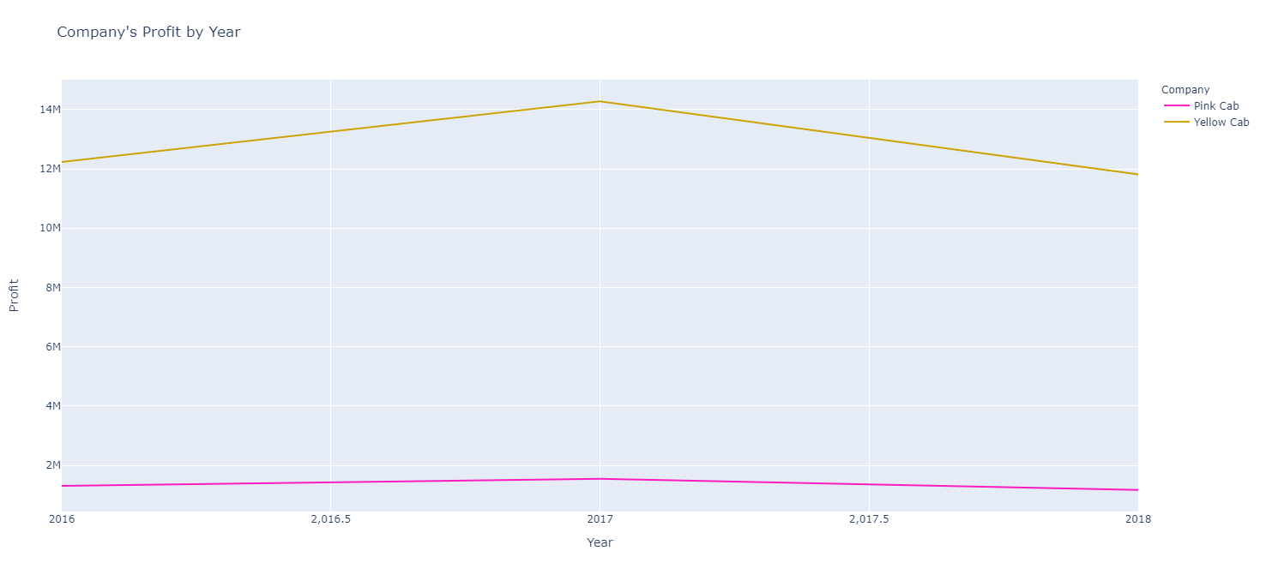
EDA – Check Profit
Check if Yellow Cab has more Profit than Pink Cab or not?
Conclusion:
Yellow Cab has more Profit than Pink Cab Overally
The baseline of Yellow Cab is upper than Pink Cab
The slope of increasing profit from 2016 to 2017 is noticeably higher in Yellow Cab than Pink Cab

Slide 5
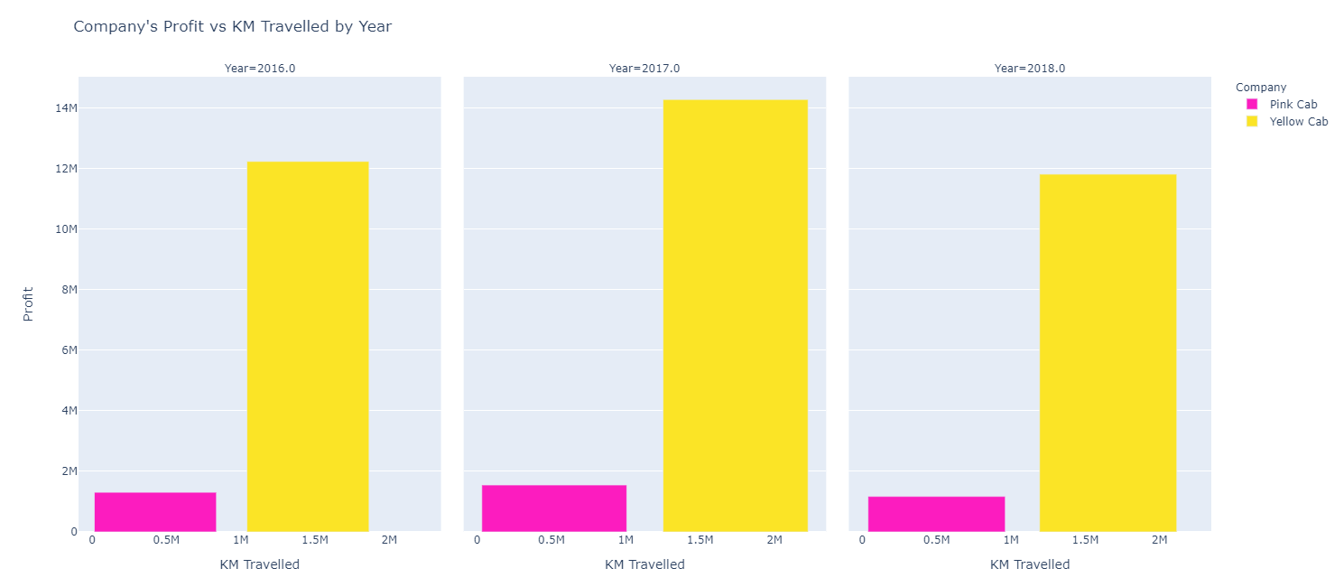
EDA – Check Profit
Is total distance that Yellow Cab travelled is higher than Pink Cab?
If Profit($) per distance(KM) is higher in Yellow Cab than Pink Cab?
Conclusion:
The total distance travelled by Yellow Cab is higher than Pink CabThe margin of the total travelled distance between two companies is somehow constant over the years

Slide 6
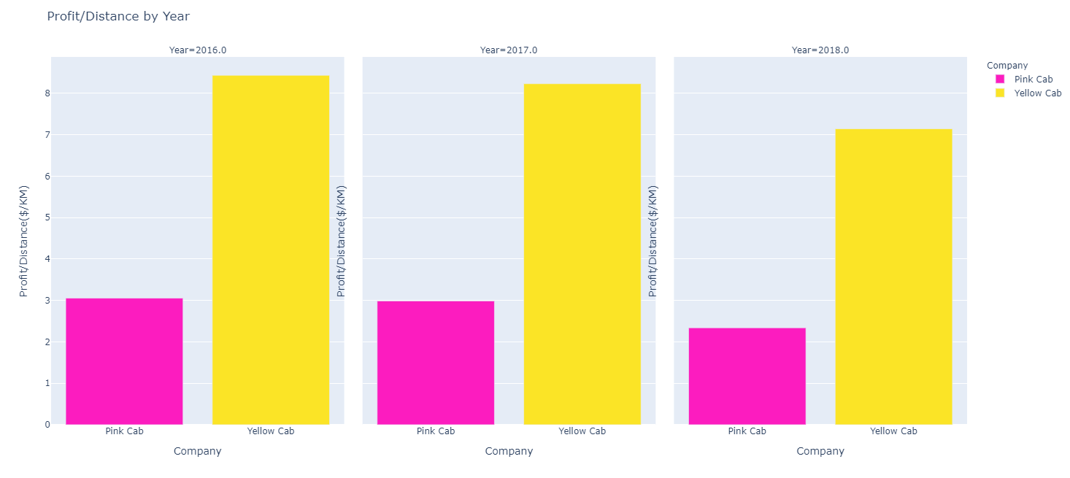
EDA – Check Profit
Is total distance that Yellow Cab travelled is higher than Pink Cab?
If Profit($) per distance(KM) is higher in Yellow Cab than Pink Cab?
Conclusion:
Travelled distance in both companies increased from 2016 to 2017, but the value of Profit/Distance is decreased in both of them
The value of Profit/Distance in Yellow Cab is noticeably higher than Pink Cab
The value of Profit/Distance in both companies decreased from 2016 to 2018
The margin of the value Profit/Distance between two companies is decreased over the years

Slide 7
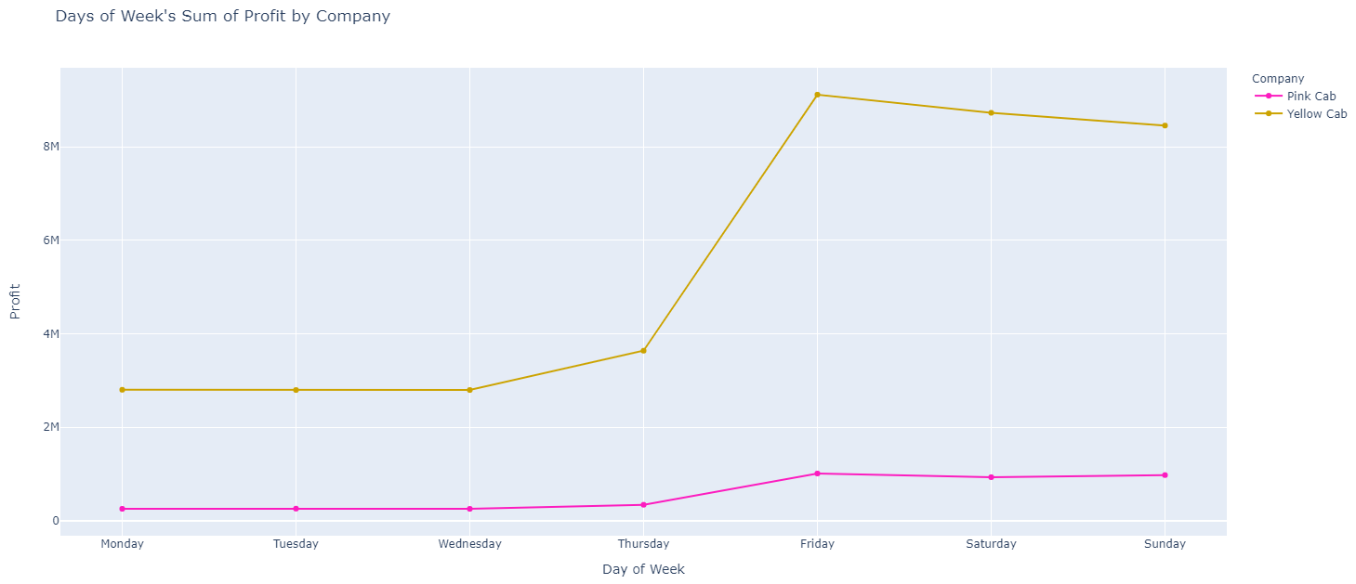
EDA – Check Profit
If there is any daily pattern for Profit?
Conclusion:
The baseline of Yellow Cab is upper than Pink Cab
The slope of increasing profit from Wednesday to Friday mostly Thursday to Friday is noticeably higher in Yellow Cab than Pink Cab
The slope of decreasing profit from Friday to Saturday is higher in Yellow Cab than Pink Cab
Yellow Cab has decreased from Saturday to Sunday, although Pink Cab has an insignificant increase in the same period

Slide 8
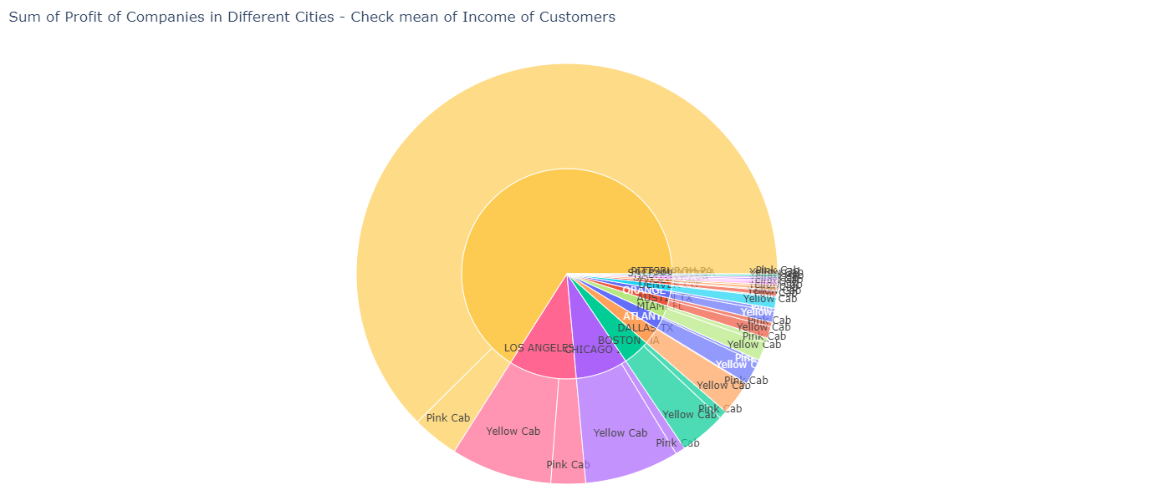
EDA – Check Profit
Which company has more Profit by Cities?
Conclusion:
In most cities specially ones that cover majority of Profit, Yellow Cab is noticebly earn much Profit than Pink Cab
NY covers the most Profit over cab industries
Income of customers in Yellow Cab and Pink Cab are almost same per City although the Profit is much different (find in HTML)

Slide 9
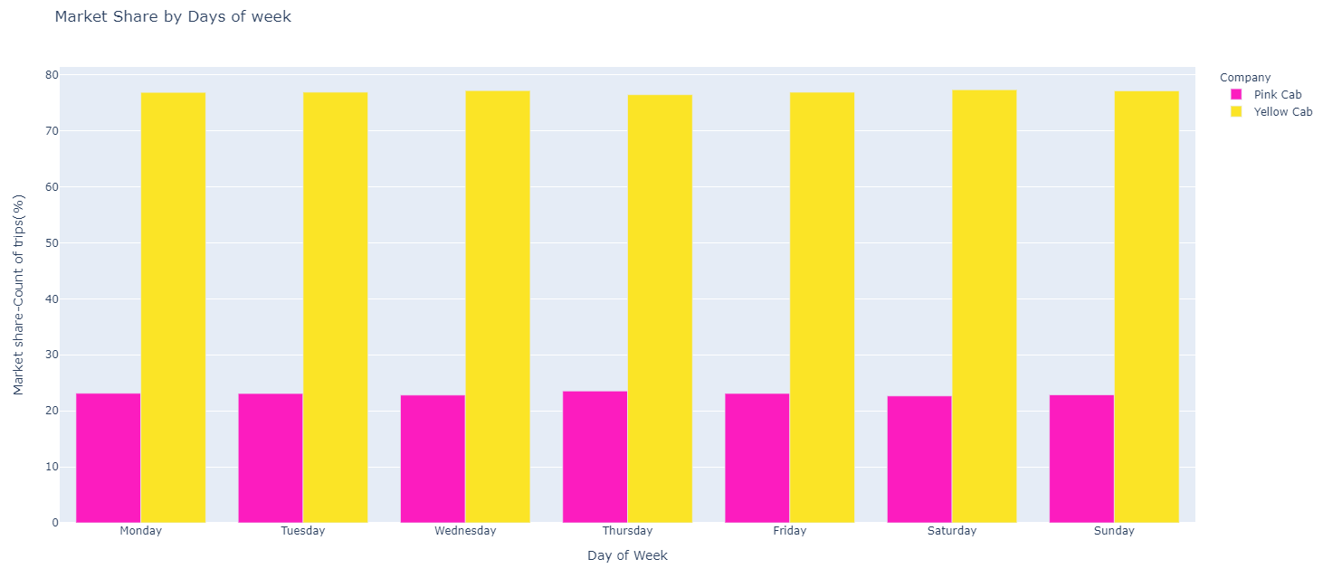
EDA – Check Counts of Trips
Is there any daily pattern for Market Share (Counts of trip) in comparison of companies?
Conclusion:
There is almost no specific daily pattern for market share for none of companies
Yellow Cab has always around 70 percent of market and the Pink Cab has 30 percent of it

Slide 10
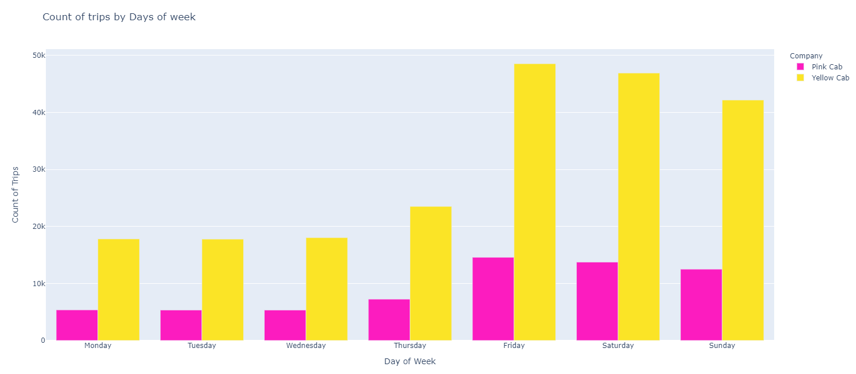
EDA – Check Counts of Trips
Is there any daily pattern for Counts of trip in comparison of companies?
Conclusion:
Both companies almost follow the same pattern for count of trips by Days of Week
Yellow Cab is more popular than Pink Cab every day!
The margin between two companies is noticeable
Both companies has the most count of trips on Friday
Conclusion:
Both companies has the most count of trips after Friday on Saturday
Yellow Cab experienced sharpen changes than Pink Cab
People use cabs mostly at weekends

Slide 11
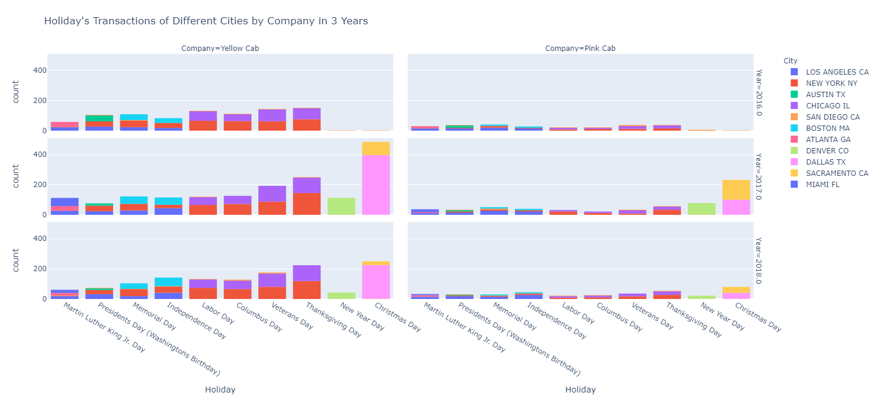
EDA – Check Counts of Trips
What happens to Count of Trips in Holidays?
Conclusion:
The Count of trips by Yellow Cab is higher than Pink Cab overally in holidays
Pink Cab has more trips on some days in some cities like trips in Sacramento CA on Chrismas day
Conclusion:
Yellow Cab is more popular than Pink Cab overally
Both cab companies have the most trips on holidays on Chrismas day
After Chrismas day, Thanksgiving day is the second popular Holiday, mostly shown in Yellow Cab trips

Slide 12
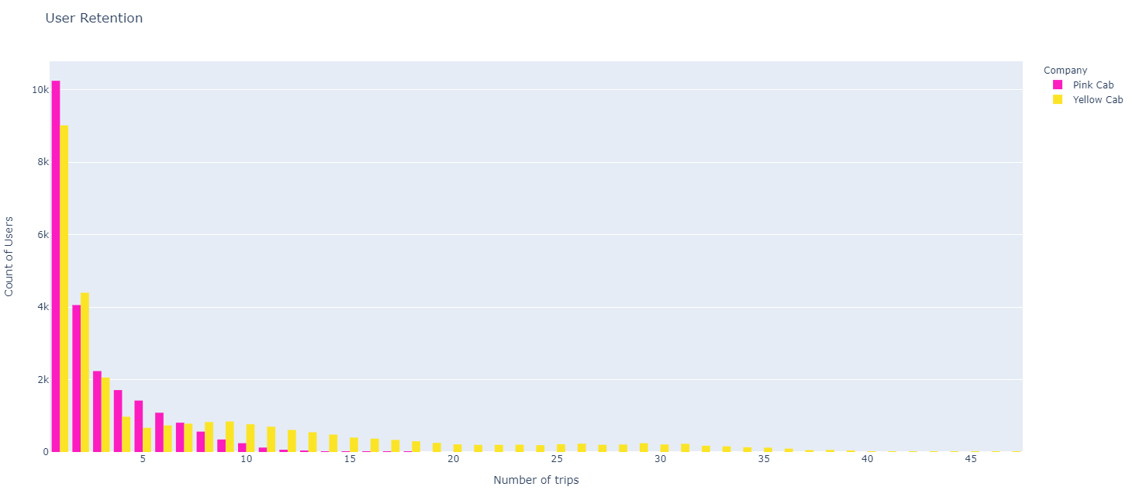
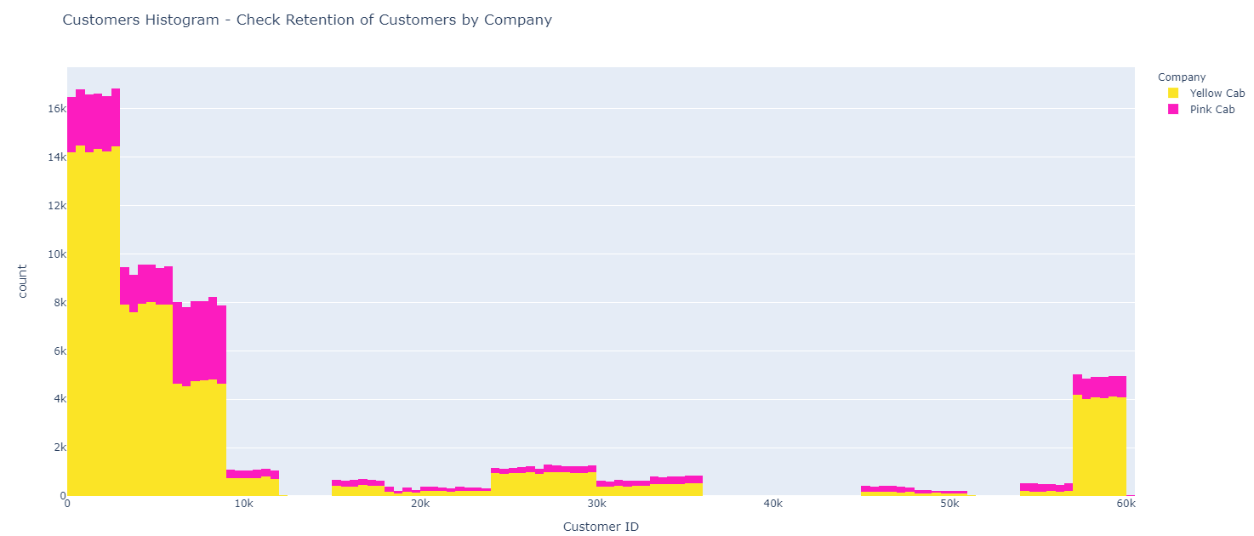
EDA – Check Customer's Behavior
Which company has the most loyal customers?
Conclusion:
Yellow Cab has more loyal customers
People who get back to Yellow Cab is noticably more than who are loyal to Pink Cab
Customers more like to get a car from Yellow Cab for another time than Pink Cab
Pink Company is more attractive at first as we can see for who only use Cab service once, Pink Company is preferable
Count of people who use one cab service is decreasing by increasing the number of trips
The maximum number of trips that one customer has done for Yellow Cab is around 45 and for Pink Cab is around 18
The number 7 in Number of Trips is a critical number which count of customers for both companies are same, less than 7 Pink Cab is more popular and more than 7 Yellow Cab is more popular

Slide 13
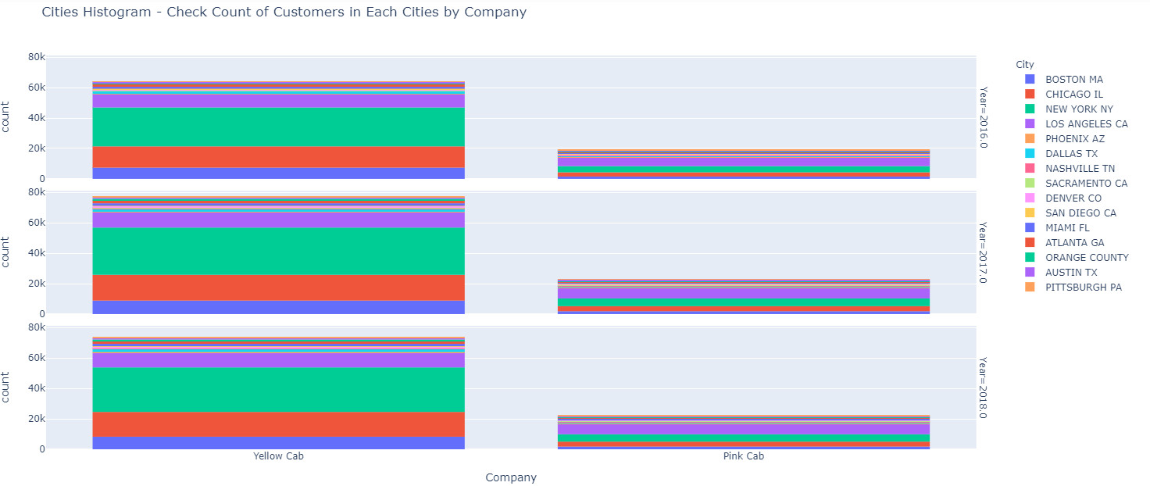
EDA – Check Customer's Behavior
How's the distribution of customers in different cities for each companies?
Conclusion:
Yellow Cab has is more popular mostly
In "PITTSBURGH PA", "SAN DIEGO CA", "SACRAMENTO CA" and "NASHVILLIE TN" Pink Cab is merely more popular than Yellow Cab
According to section 1.4 the cities which mentioned above can not provide much Profit for Pink Cab

Slide 14
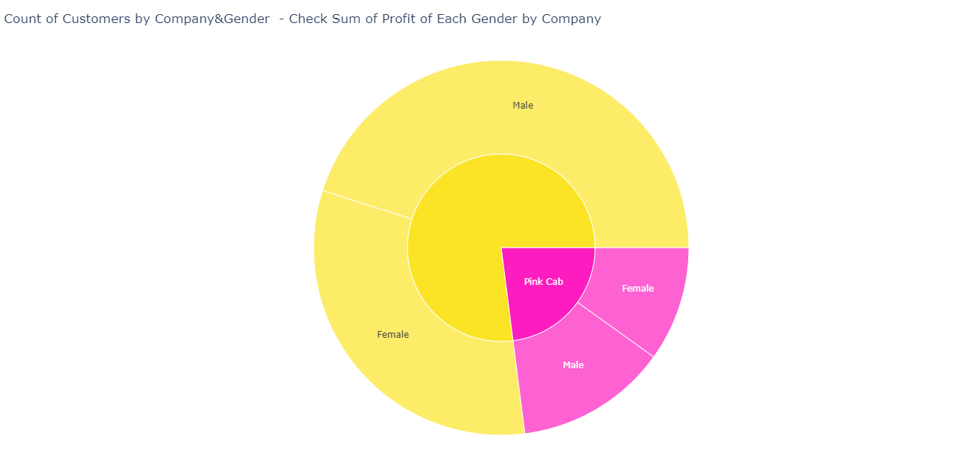
EDA – Check Customer's Behavior
Customer's gender has an effect on Profit and counts of trip or not?
Conclusion:
Males are majority by slim margin in both companies
Males bring more profit for cab industry
Yellow Cab has noticebly more customers both in Male and Female groups

Slide 15
Conclusion
Yellow Cab has more profitable manner
Yellow Cab experience more sharpen effects than Pink Cab, both in increasing and decreasing profit and other factors
Investing in Yellow Cab can be a better solution based on the three years data, it's rarely possible that Yellow Cab experience a decline
Investing on Yellow Cab is somehow more riskey as if it face an issue the effects on it can be more noticeably than Pink Cab
A small fault can cause a huge decline in Yellow Cab's Profit than Pink Cab
If everything goes right, the Yellow Cab company can become bigger and bigger, and investing in it can be the best decision

Slide 16

Any questions?
Thank You

